Slide 1


Slide 2
The Philippine Economy:
2011 and Beyond
Three Growth Sectors
  Business Process Outsourcing
  Tourism
  Mining
Hard Infrastructure Support
  Transport and Telecommunications
  Utilities
  Power
  Facilities
Soft Infrastructure Support
  Education
  Governance
  Finance

Slide 3
Construction Industry
Construction Output (in billion USD) and share to total GDP (%)
Source: NSCB

Slide 4
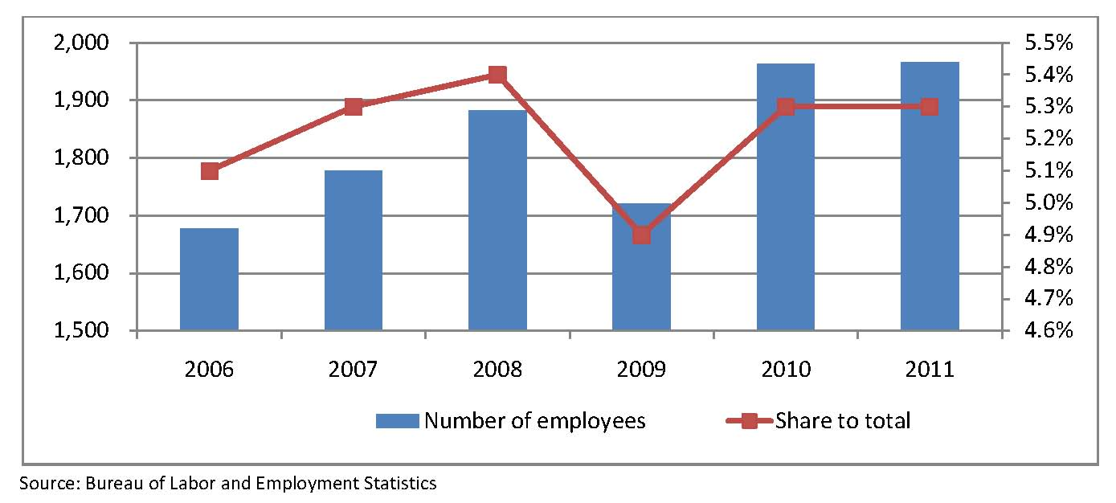
Construction Industry
Employment in the Construction Industry (in Thousand)

Slide 5
Construction Industry
213
126
163
1,895
1,217
1,044
1,992
Total licensed contractors = 3,325
Source: PCA Industry Report

Slide 6
Construction Industry
Source: PCA Industry Report

Slide 7
Construction Industry
Prospects
Tourism – hotels, airports
BPO – buildings
Mining – office sites, mine development
Power – power plants
PPP / Infrastructure – PPP list

Slide 8
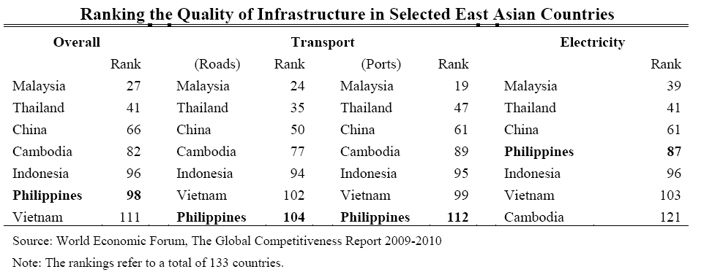

Slide 9
Road
Tarlac-Pangasinan-La Union Expressway (TPLEX)
88 km initially two-lane road
5-year construction
BTO with 30-year concession
$345M – project cost with $84M government subsidy
Construction started in 2Q 2010; $43M

Slide 10
Construction Industry
TOLL ROADS
Daang Hari- Slex Link (ongoing) $36M
LIGHT RAIL
LRT 1 South Extension $1.5B
Cavite-Laguna (North-South) Expressway $233M
NLEX-SLEX Connector $477M
LRT Line 2 Phase 2 $251M
TPLEX Tarlac-La Union (ongoing) $345M
NAIA Expressway Phase 2 $235M
Prospective Public-Private Partnership (PPP) List

Slide 11
Construction Industry
Prospective Public-Private Partnership (PPP) List
AIRPORTS
Bohol Airport $169M
EDUCATION
School Infrastructure Projects $233M
Puerto Princessa $98M
Legaspi Airport $71M
O&M Laguindingan Airport $33M

Slide 12
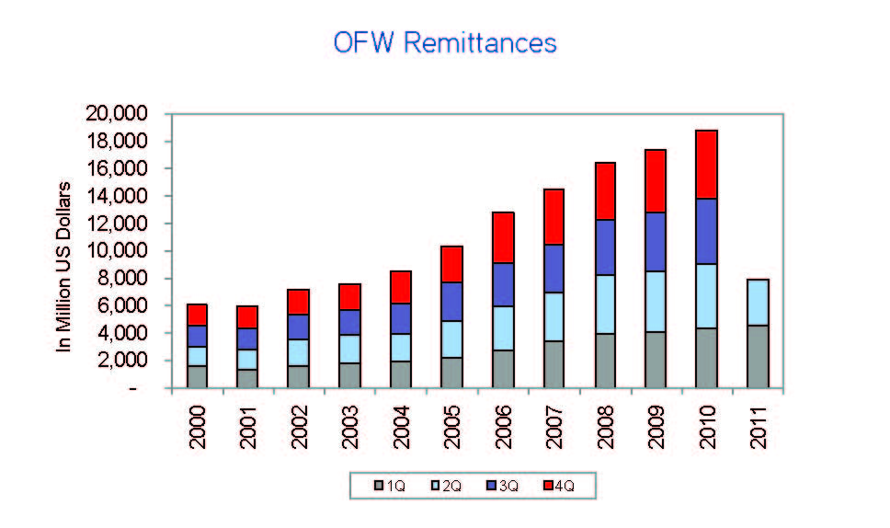
Real Estate
OFW REMITTANCES
F
Source: BSP

Slide 13
Real Estate
Issued Licenses to Sell
Source: HLURB

Slide 14
Real Estate
BIR: Increased Threshold for VAT Exemption in 2012
Not subjected to VAT
Sale of a residential lot which is not more than USD46 thousand per unit from USD35 thousand
Sale of a residential house and lot which is not more than USD74 thousand from USD58 thousand
Lease of residentuial units which is not more than USD296.00

Slide 15
Real Estate
Foreign Ownership limitation on owning real properties
Entry Points
REIT – currently under discussion
Listed real estate companies

Slide 16
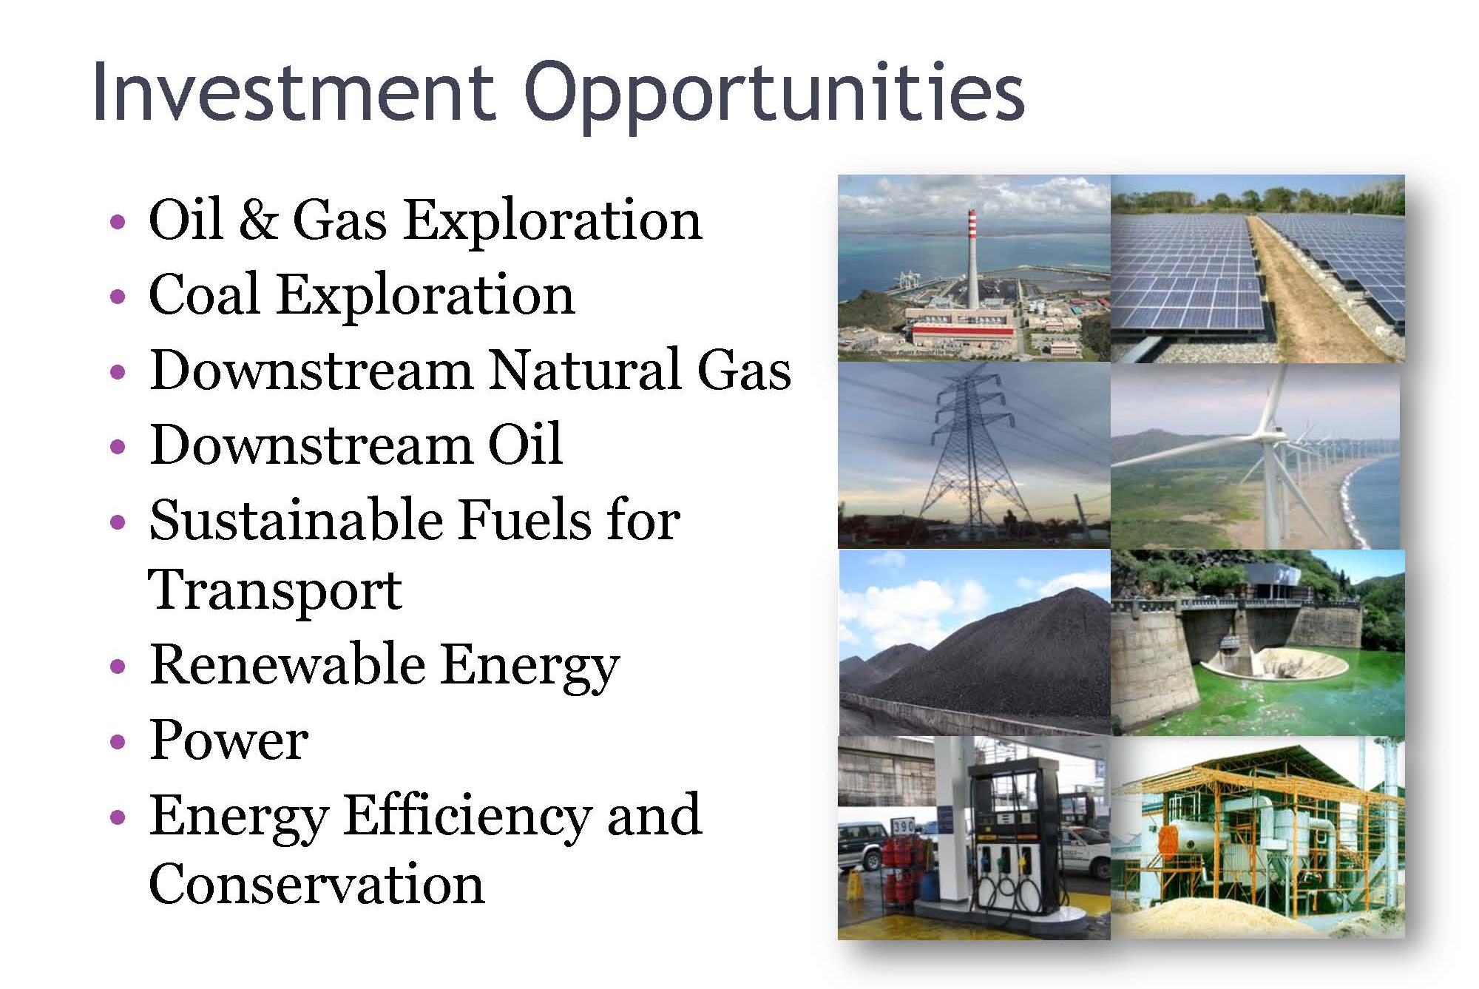
Energy
Source: DOE, Investment Opportunities Report by Usec. Asirit

Slide 17
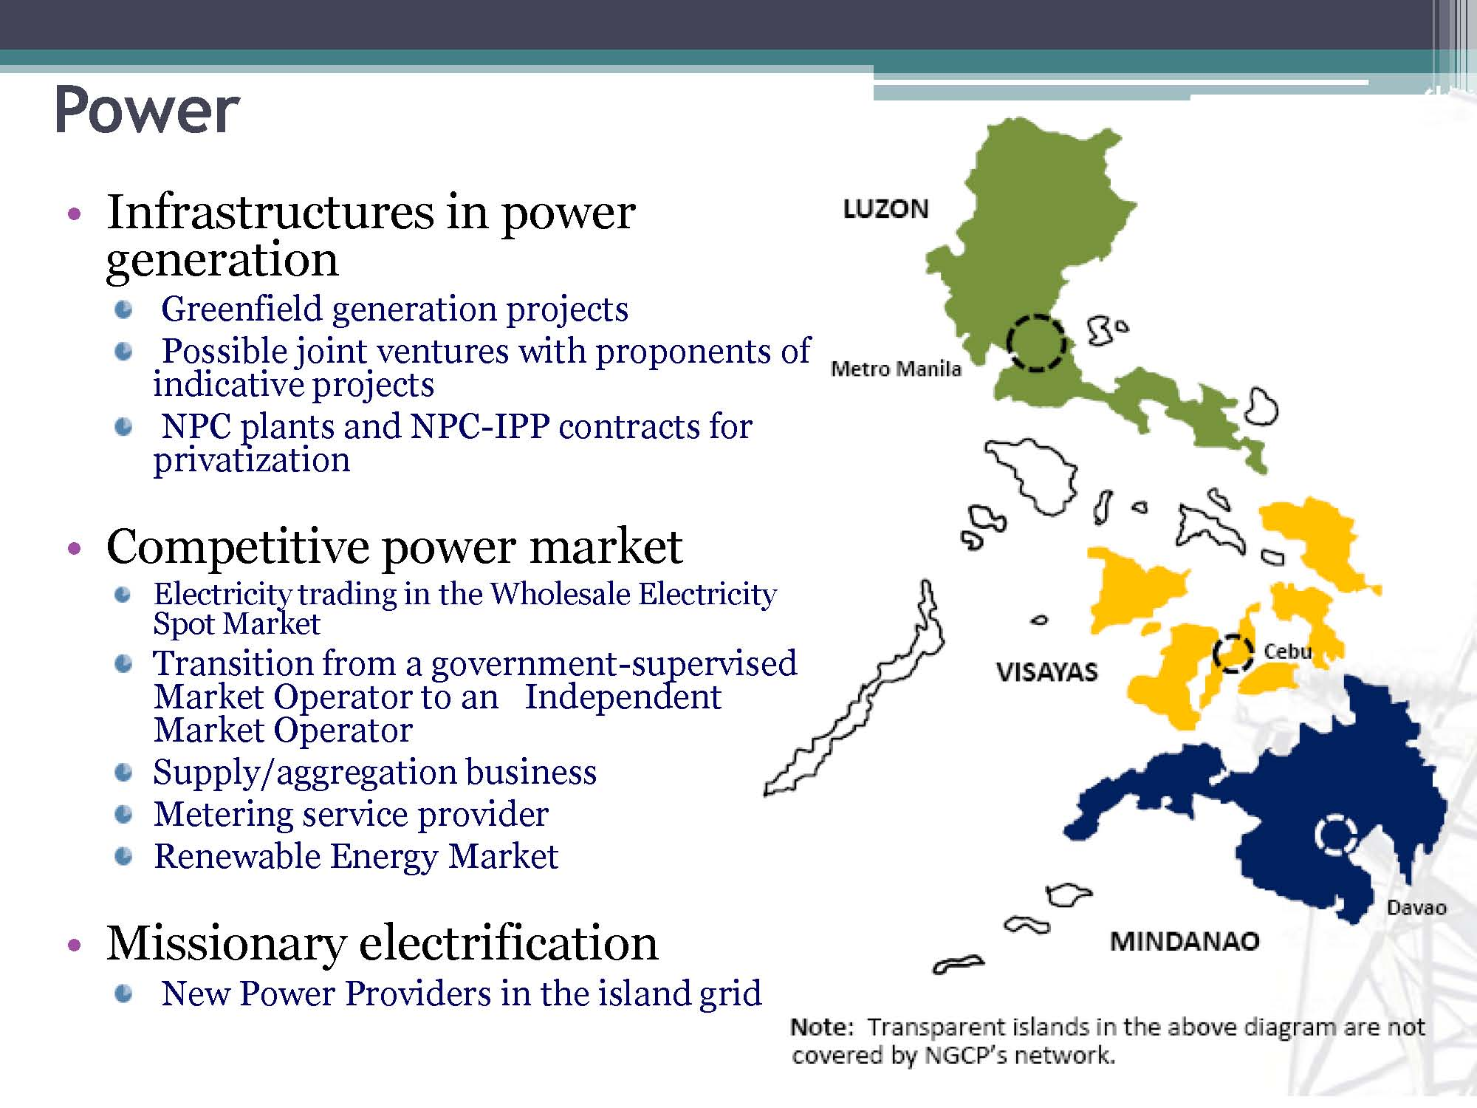
Energy
Source: DOE, Investment Opportunities Report by Usec. Asirit

Slide 18
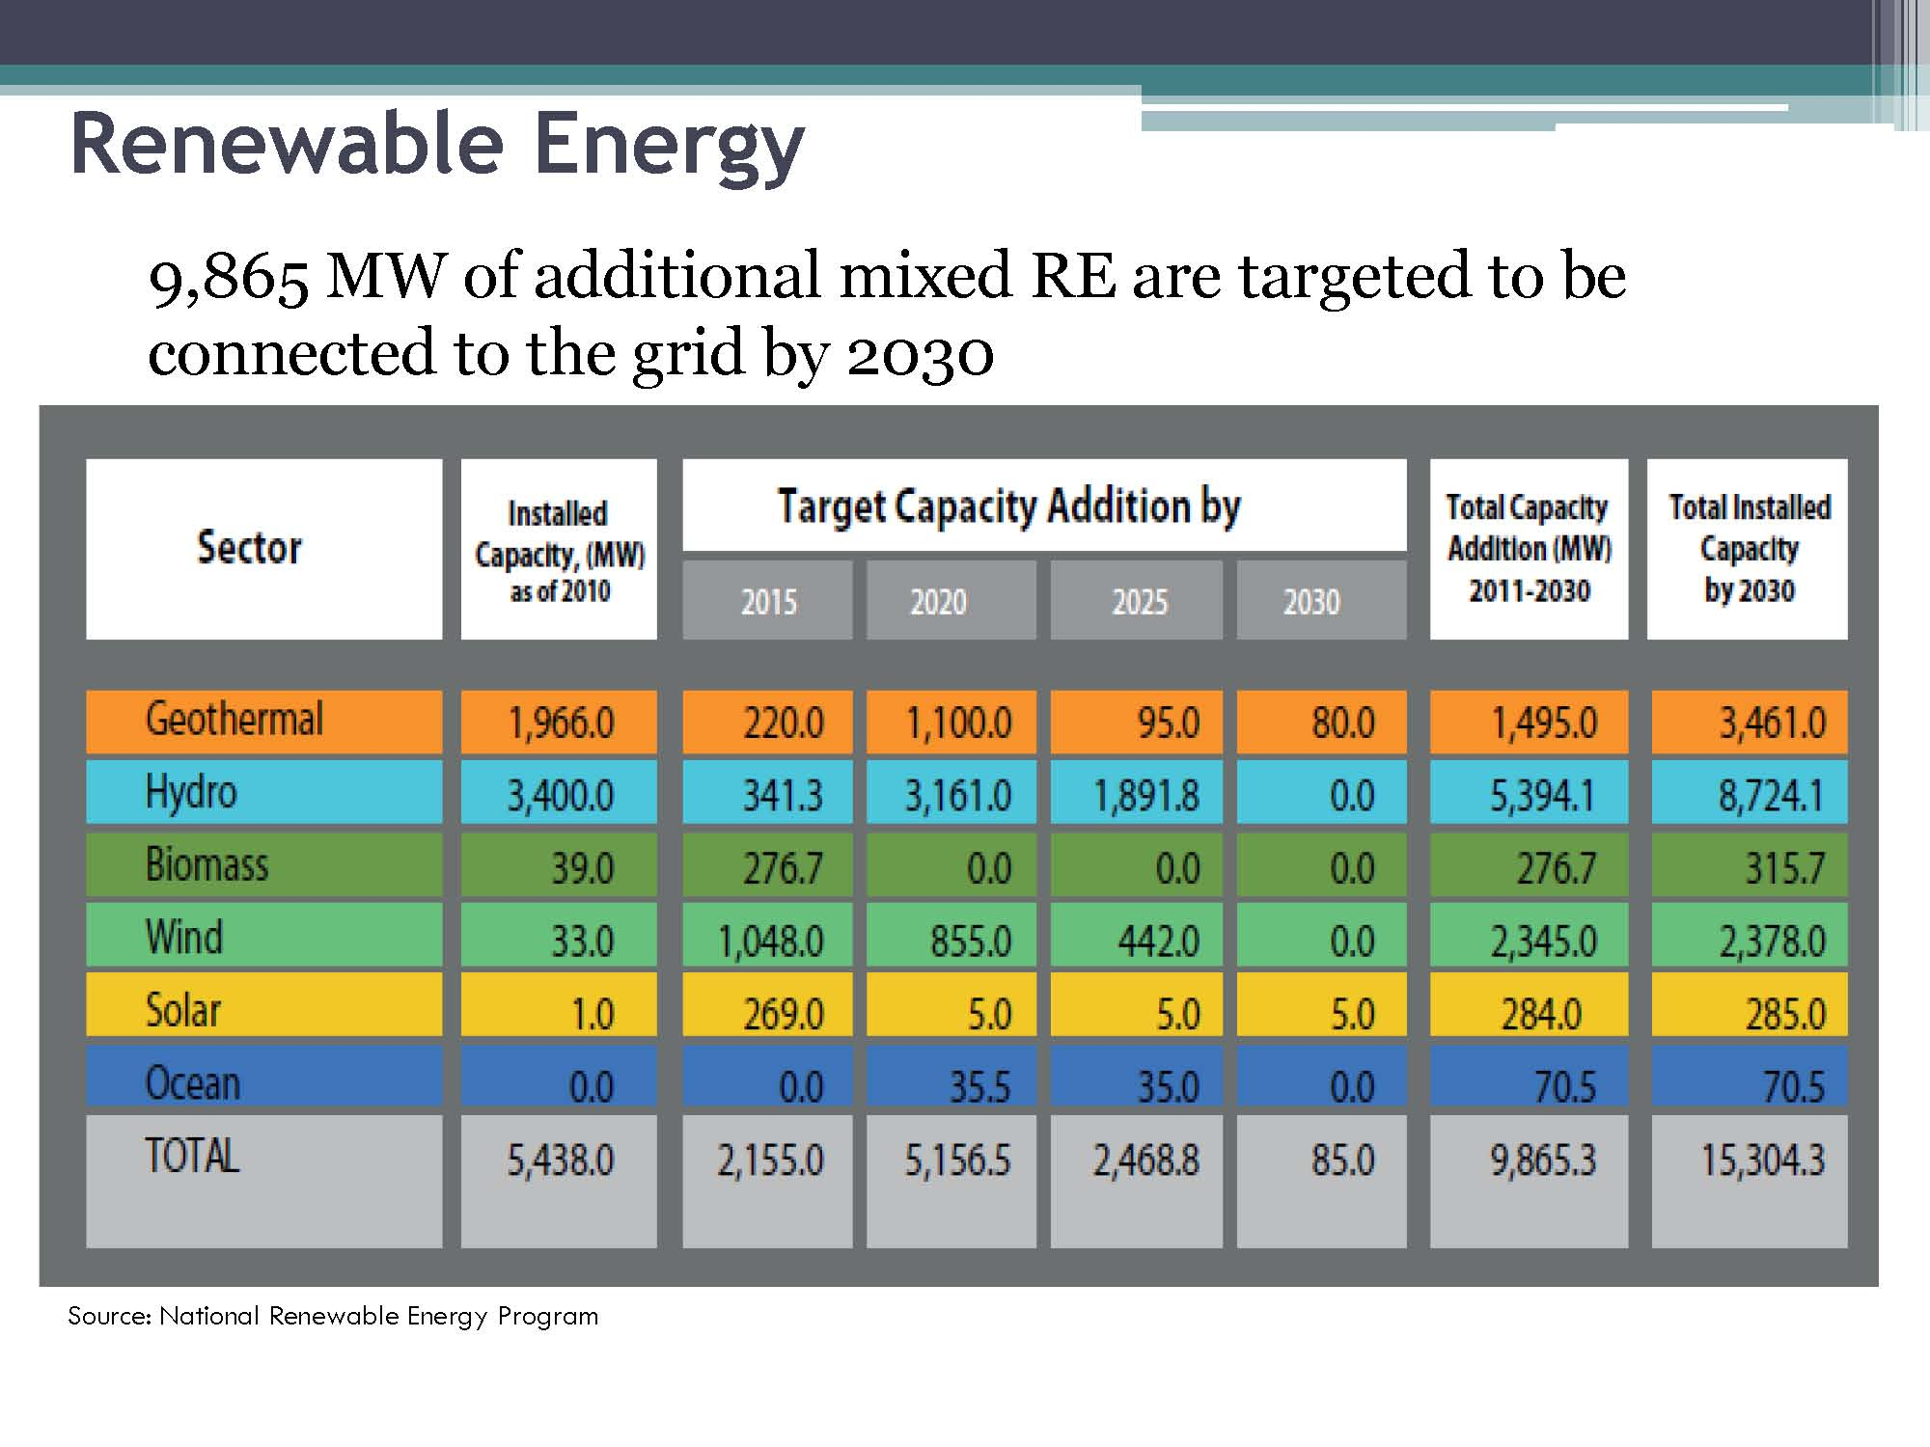
Energy
TOTAL
5,438.0
838.0
5,116.0
2,428.8
80.0
9,510.8
14,878.8
Source: DOE, Investment Opportunities Report by Usec. Asirit

Slide 19
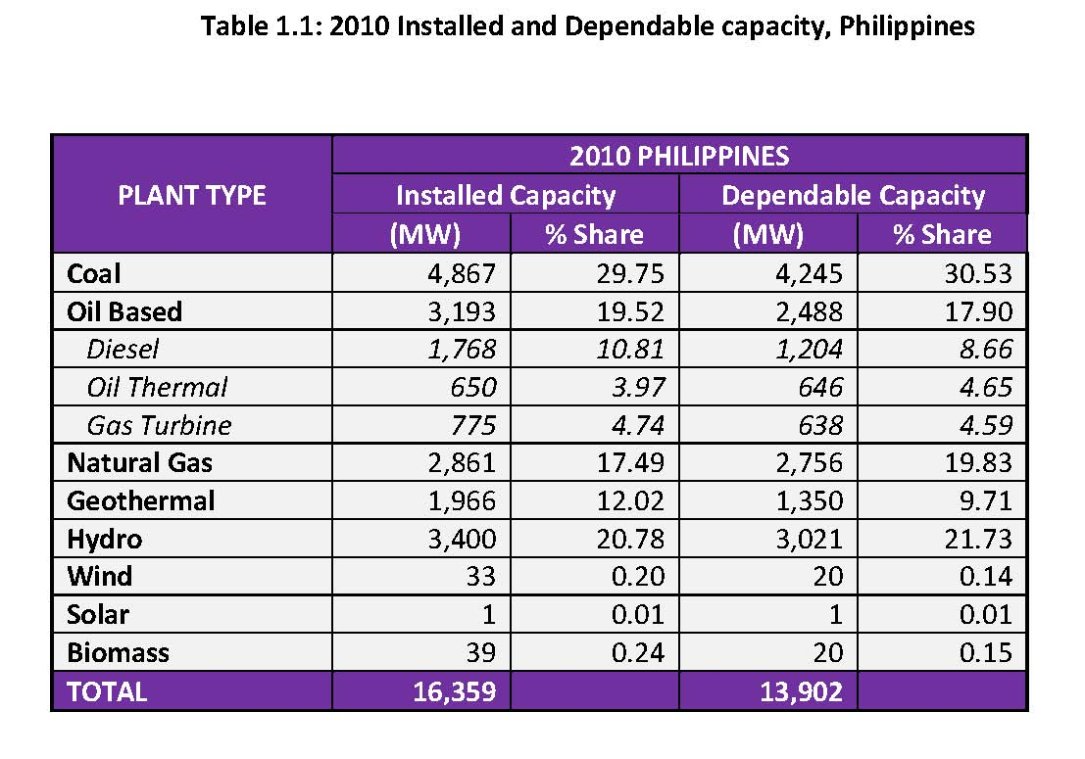
Energy
Installed and Dependable Capacity, Philippines
Source: DOE, 2010 Power Situationer Report

Slide 20
Energy
Installed and Dependable Capacities in MW, Total Philippines
Installed capacity = 16,359 MW
Dependable capacity = 13,902 MW
Source: DOE, 2010 Power Situationer Report

Slide 21
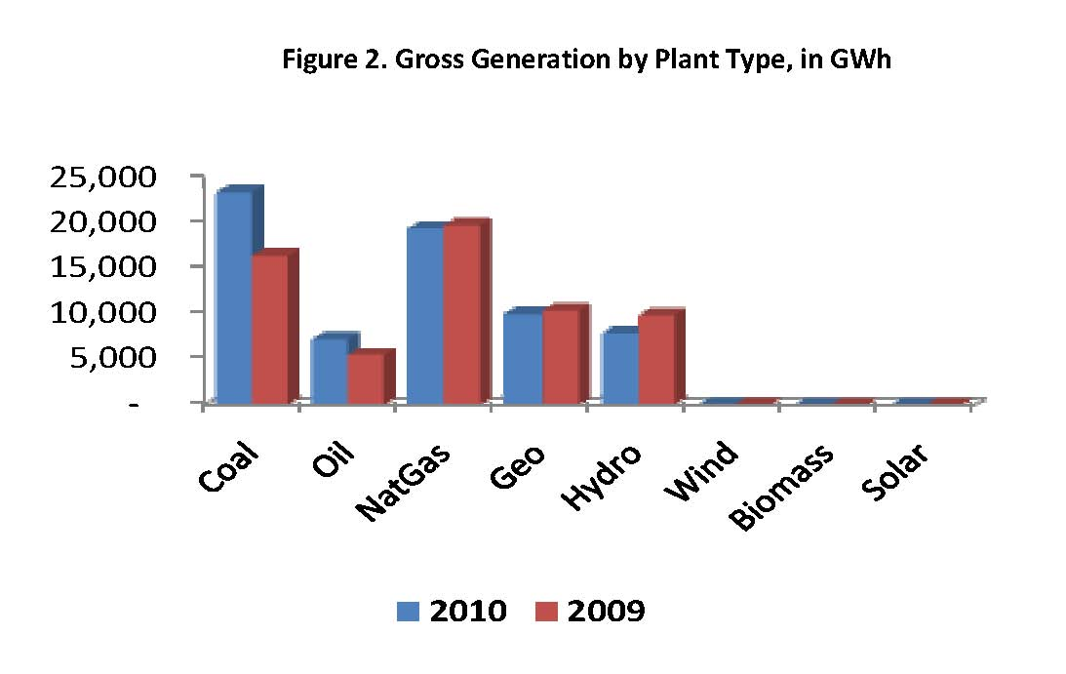
Energy
Gross Generation by Plant Type, in GWhr
Source: DOE, 2010 Power Situationer Report

Slide 22
Energy
2010 Gross Power Generation, Philippines
Total Generation = 67,743 Gwh
Source: DOE, 2010 Power Situationer Report

Slide 23
Energy
Generation by Ownership, in GWhr
Total Philippines
19,786 GWh
48,442 GWh
Source: DOE, 2010 Power Situationer Report

Slide 24
Energy
MW
Supply-Demand Outlook
2011-2020
MW
2021-2030
The Philippines needs a total additional capacity of 14,100 MW onwards to 2030
Source: DOE, 2011 Power Demand and Supply outlook

Slide 25
Mabuhay!

